Slide 1
Pruning convolution Neural networks
By:
Anurag singh
Anusha Jain

Slide 2
Convolution NEURAL NETWORKS
Currently hyped , widely used application with impressive performance for
Object Detection
Recognition
Object Tracking
Semantic Segmentation
Drawbacks:
High computation power and cost
Heavy networks
Huge number of parameters and redundancy in weights

Slide 3
Solution : pruning
This technique is used to make the deep neural networks small and fast
How does it work????
Removing layers from the neural network to reduce its size
Ranking the neurons according to how much they contribute and removing the lower rank neurons
Keeping the neurons which weren’t zero on a validation set

Slide 4
PRUNING Techniques
Pruning Filters
Reducing computation cost by pruning trivial filters ( reduce weights in each filter or remove a specific dimension of a single kernel)
Pruning Weights
Compressing CNN by removing weights with smaller magnitude

Slide 5
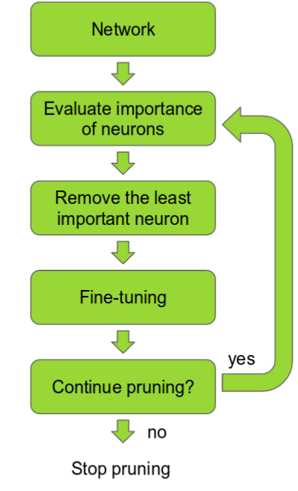
Pruning is an iterative process – often called ‘Iterative Pruning’

Slide 6
Success Matrix
Pruning results in a trade off between network size and accuracy of the network
Factors that indicate the success or failure of this technique are:
Network Size
Accuracy
Computational Time
Computational Cost
Evaluate: Pruning effect on pretrained larger network v/s own built smaller network

Slide 7
Project architecture
DATA:
CIFAR10 : image classification data
COCO : Common objects in context image dataset
MODEL:
CNN : built on CIFAR10 dataset
VGG16 : Pre-trained model on ImageNet dataset
SSD MobileNet : Pre-trained model on COCO Dataset

Slide 8
Thank YOU !!! ☺

